Slide 1
CS 3006 Parallel and Distributed Computing Lecture 24
Danyal Farhat
FAST School of Computing
NUCES Lahore

Slide 2
Sorting in Parallel Era

Slide 3
Outline
Sorting: Overview
Sorting: Basics
Sorting: Parallel Compare Exchange Operation
Sorting: Parallel Compare Exchange Operation [cost estimation]
Bubble Sort and its Variants
Bubble Sort [Odd-Even Transposition]
Odd-Even Sort (Seq. Complexity)
Parallel Odd-Even Sort
Parallel Odd-Even Sort Implementation

Slide 4
Sorting: Overview
One of the most commonly used and well-studied Algorithms
Sorting can be comparison-based or non-comparison-based
The fundamental operation of comparison-based sorting is compare-exchange
The lower bound on any comparison-based sort of n numbers is Θ(nlog n)
Let’s explore a comparison-based sorting algorithm.

Slide 5
Sorting: Basics
What is a parallel sorted sequence?
Where are the input and output lists stored?
Answers:
We assume that the input and output lists are distributed
The sorted list is partitioned with the property that each partitioned list is sorted and each element in processor Pi's list is less than that in Pj's list if i < j

Slide 6
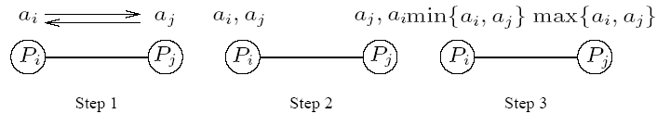
Sorting: Parallel Compare Exchange Operation
A parallel compare-exchange operation
Processes Pi and Pj send their elements to each other
Process Pi keeps min{ai,aj}, and Pj keeps max{ai, aj}

Slide 7
Sorting: Parallel Compare Exchange Operation [cost estimation]
If each processor has one element, the compare exchange operation stores smaller element at the processor with smaller id
This can be done in ts + tw time
If we have more than one element per processor, we call this operation a compare split.
Assume each of two processors have n/p elements:
After the compare-split operation, the smaller n/p elements are at processor Pi and the larger n/p elements at Pj, where i < j

Slide 8
Sorting: Parallel Compare Exchange Operation [cost estimation] (Cont.)
The time for a compare-split operation is (ts+ tw * n/p), assuming that the two partial lists were initially sorted
Note that this time is only accounting communication costs
Computation and memory complexities are separate things

Slide 9
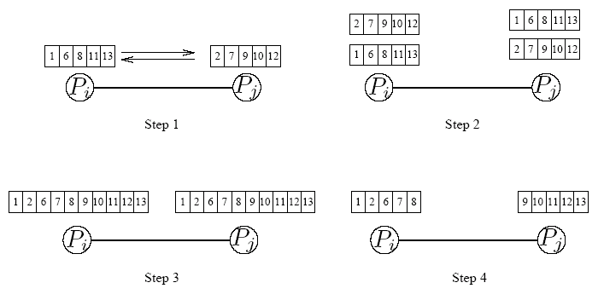
Sorting: Parallel Compare Exchange Operation
A compare-split operation. Each process sends its block of size n/p to the other process. Each process merges the received block with its own block and retains only the appropriate half of the merged block. In this example, process Pi retains the smaller elements and process Pj retains the larger elements.

Slide 10
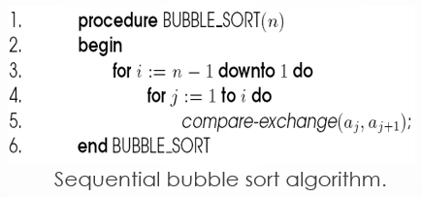
Bubble Sort and its Variants
The sequential bubble sort algorithm compares and exchanges adjacent elements in the sequence to be sorted:

Slide 11
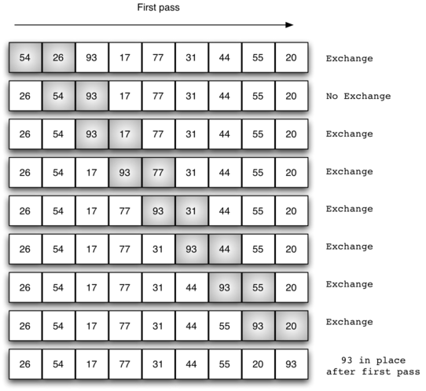
Bubble Sort and its Variants (Cont.)

Slide 12
Bubble Sort and its Variant (Cont.)
The complexity of bubble sort is Θ(n * n)
Bubble sort is difficult to parallelize since the algorithm has no concurrency
A simple variant, though, uncovers the concurrency

Slide 13
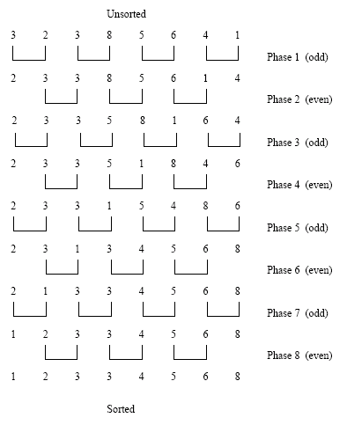
Bubble Sort [Odd-Even Transposition]
Sorting n = 8 elements, using the odd-even transposition sort algorithm. During each phase, at most 8 elements are compared. [This according to sequential algorithm]

Slide 14
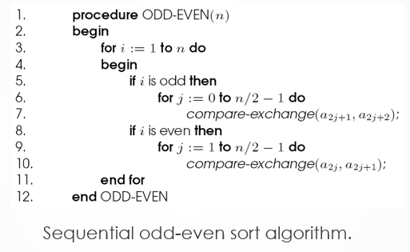
Bubble Sort [Odd-Even Transposition] (Cont.)

Slide 15
Odd-Even Sort (Seq. Complexity)
After n phases of odd-even exchanges, the sequence is sorted
Each phase of the algorithm (either odd or even) requires Θ(n) comparisons
Serial complexity is Θ(n * n)

Slide 16
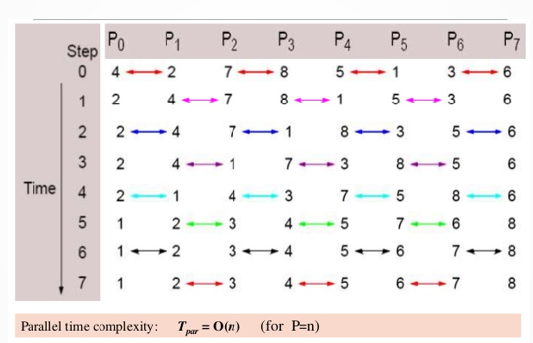
Parallel Odd-Even Sort

Slide 17
Parallel Odd-Even Sort (Cont.)
Algorithm Through Observations:
There are total P phases/steps. Where P is number of processes
For even phases
If ‘myrank’ is even - Communication partner is (‘myrank’+1)
If ‘myrank’ is odd - Communication partner is (‘myrank’ - 1)
For odd phases
If ‘myrank’ is even - Communication partner is (‘myrank’ - 1)
If ‘myrank’ is odd - Communication partner is (‘myrank’+1)
Communication partners remain constant
If ‘myrank’ is less-than the partner, then keep lower values in compare-split-operation

Slide 18
Parallel Odd-Even Sort (Cont.)
Complexity when n==P
Consider the one item per processor case
There are P iterations, in each iteration, each processor does one compare-exchange
The parallel run time of this formulation is Θ(n)
Parallel run time means computation performed by each of the processors in parallel

Slide 19
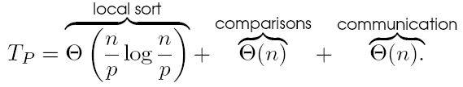
Parallel Odd-Even Sort (Cont.)
Complexity when n > P
Consider a block of n/p elements per processor
The first step is a local sort
In each subsequent step, the compare exchange operation is replaced by the compare split operation.
The parallel run time of the formulation is:
Notes:
Total comparisons done by a single process in whole algorithm
Total communication done by a single process during whole algorithm
Comparisons= total split operations * complexity of each operation= P * N/P ==O(N)

Slide 20
Reading Assignment: Parallel Odd-Even Sort Implementation
#include <stdlib.h>
#include <mpi.h> /* Include MPI's header file */
main(int argc, char *argv[])
{
int n; /* The total number of elements to be sorted */
int npes; /* The total number of processes */
int myrank; /* The rank of the calling process */
int nlocal; /* The local number of elements, and the array that stores them */
Notes:
Just go through the code.

Slide 21
Reading Assignment: Parallel Odd-Even Sort Implementation (Cont.)
int *elmnts; /* The array that stores the local elements */
int *relmnts; /* The array that stores the received elements */
int oddrank; /* The rank of the partner during odd-phase communication */
int evenrank; /* The rank of the partner during even-phase communication */
int *wspace; /* Working space during the compare-split operation */

Slide 22
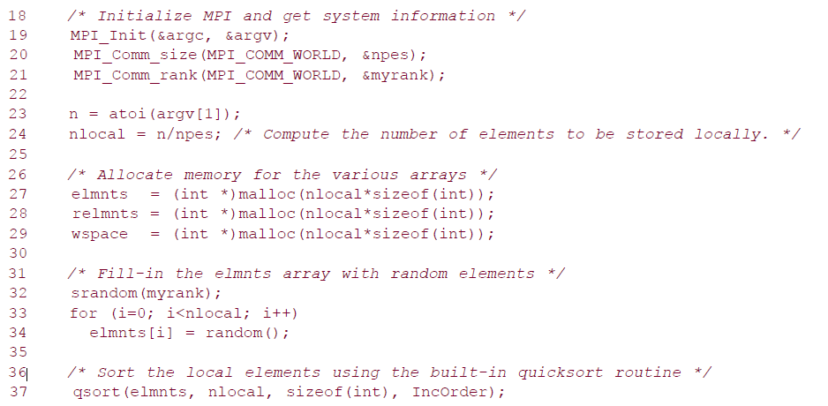
Reading Assignment: Parallel Odd-Even Sort Implementation (Cont.)
Notes:
Initializing local arrays and performing local sort

Slide 23
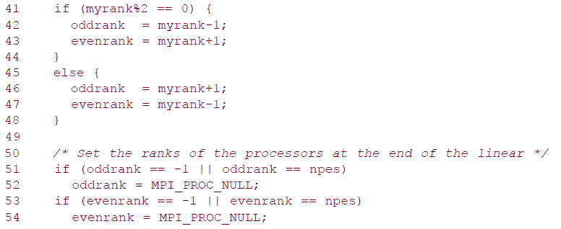
Reading Assignment: Parallel Odd-Even Sort Implementation (Cont.)
Determining communication partner during Even and odd steps of the algorithm
If my partner is out of bounds, then set it to NULL process
Notes:
Determining communication partners in odd and Even phases.

Slide 24
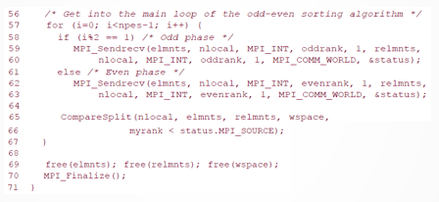
Reading Assignment: Parallel Odd-Even Sort Implementation (Cont.)
P Steps for actual algorithm

Slide 25
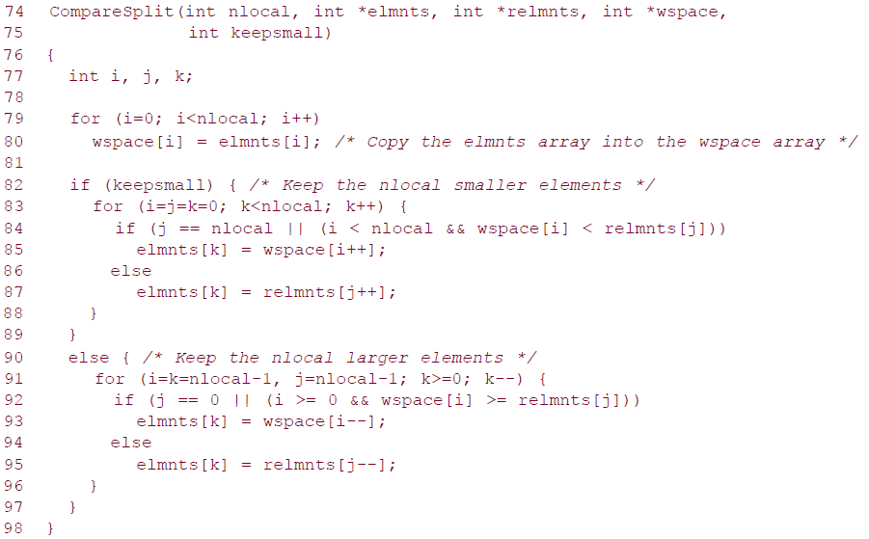
Reading Assignment: Parallel Odd-Even Sort Implementation (Cont.)
Compare-Split function
Notes:
Works same as merge function in merge sort works

Slide 26
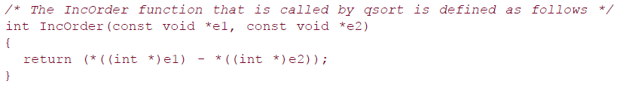
Reading Assignment: Parallel Odd-Even Sort Implementation (Cont.)
IncOrder function

Slide 27
Summary
Sorting: Overview
Most commonly used and well-studied Algorithms
Sorting: Basics
Assumption: input and output lists are distributed
Sorting: Parallel Compare Exchange Operation
Process Pi keeps min{ai,aj}, and Pj keeps max{ai, aj}
Sorting: Parallel Compare Exchange Operation [cost estimation]
For process with one element - ts + tw time
For process with more than one element - ts+ tw * n/p

Slide 28
Summary (Cont.)
Bubble Sort and its Variants
Sequential bubble sort algorithm compares and exchanges adjacent elements in the sequence
Bubble sort is difficult to parallelize
Bubble Sort [Odd-Even Transposition]
Provides parallelism to bubble sort
Odd-Even Sort (Seq. Complexity)
After n phases of odd-even exchanges, the sequence is sorted
Parallel Odd-Even Sort
If ‘myrank’ is less-than the partner, then keep lower values in compare-split-operation
Parallel Odd-Even Sort Implementation

Slide 29
Additional Resources
Introduction to Parallel Computing by Ananth Grama and Anshul Gupta
Chapter 6: Programming Using Message Passing Paradigm

Slide 30
Questions?

